Slide 1
Face and Number Recognition System
With the help of 8*8 tensors, Vectors and Deep Convolutional Neural Network

Slide 2
Main Libraries Used
Open CV
NumPy
Face_Recognition
Dlib
Matplotlib
PIL
OS
Time

Slide 3
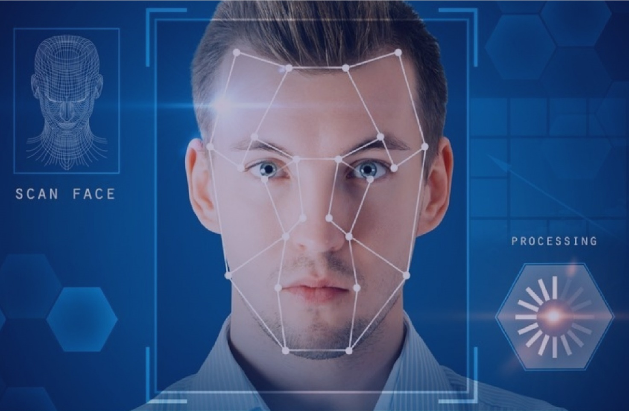
Introduction to Image Recognition
Image recognition is the processing of the image seen by the machine (computer) in such a way that by analyzing the digital data recording, it is possible to classify the observed objects in order to make further decisions.

Slide 4
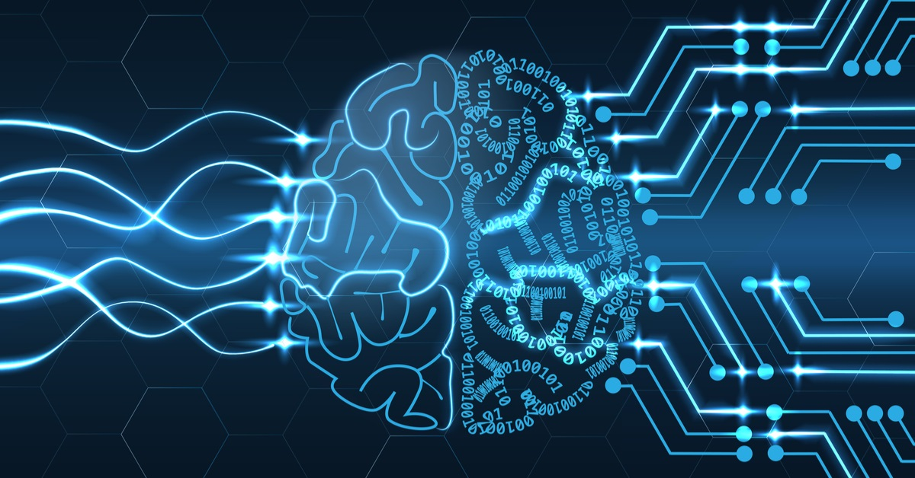
Machine Learning vs Human Brain
The simple difference is that human beings use their brain, ability to think, memory, while AI machines depend on the data given to them. They can learn from information and through regular training.

Slide 5
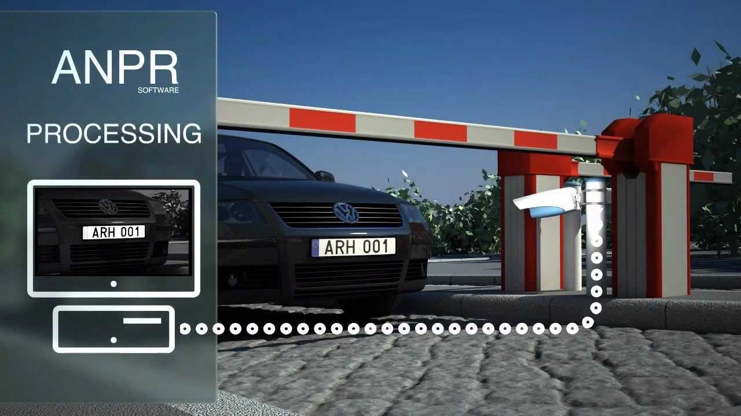
Number Recognition System
Here you can see car’s number is being recognized by machine itself.

Slide 6
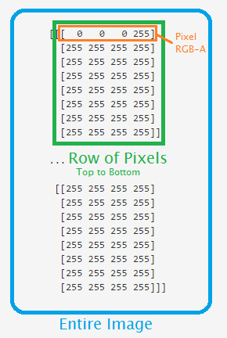
Images into Pixel Arrays

Slide 7
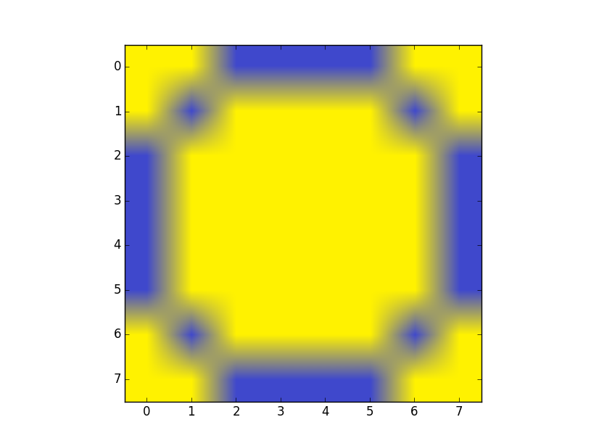
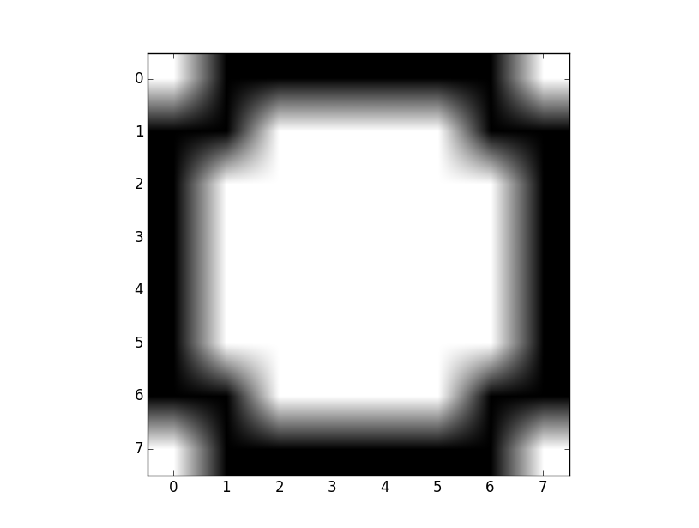
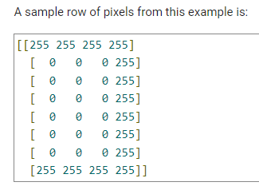
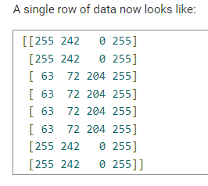
Thresholding an Image

Slide 8
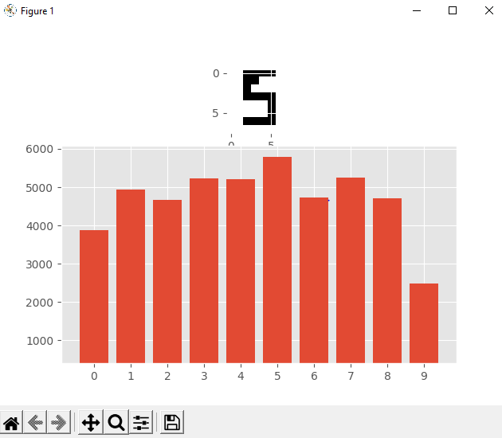
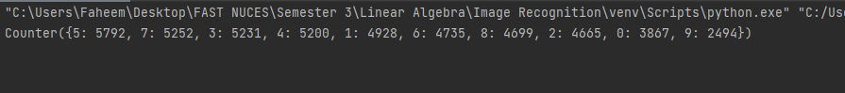
Testing Results of Number Recognition

Slide 9
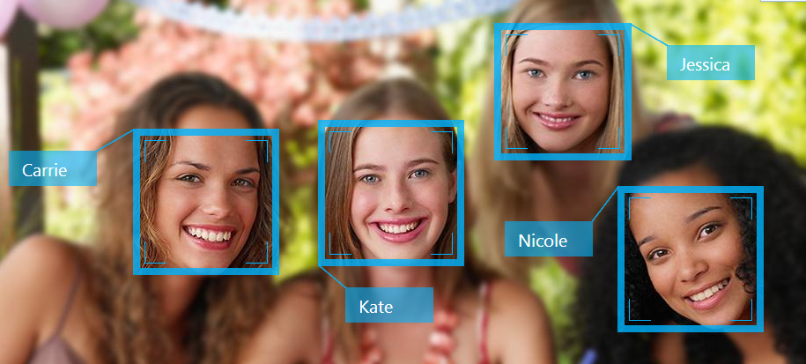
Facial Recognition

Slide 10

Steps of Facial Recognition

Slide 11
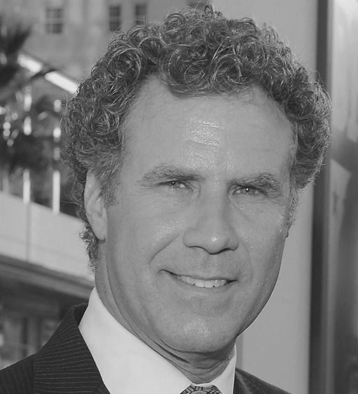
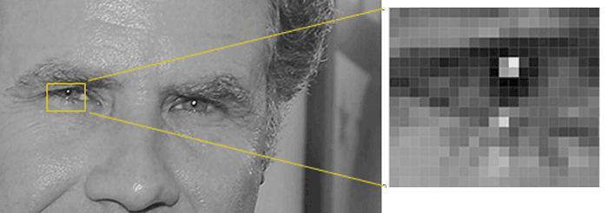
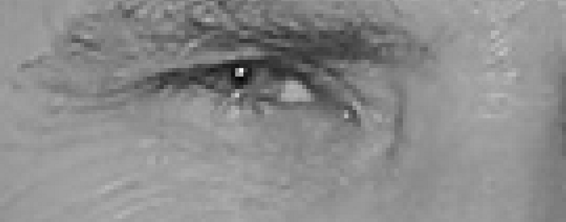
1) Finding the Faces

Slide 12
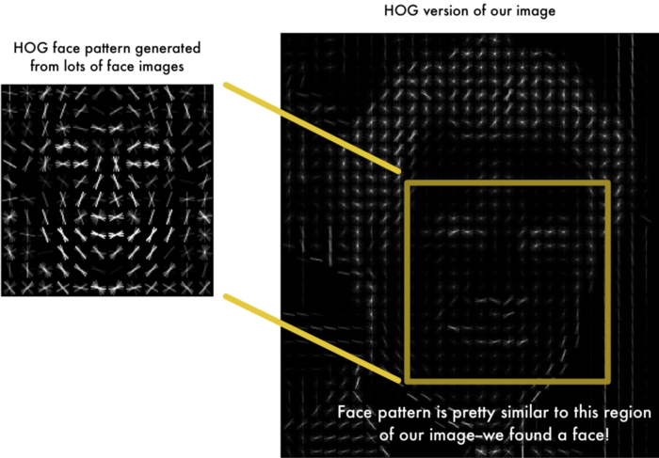
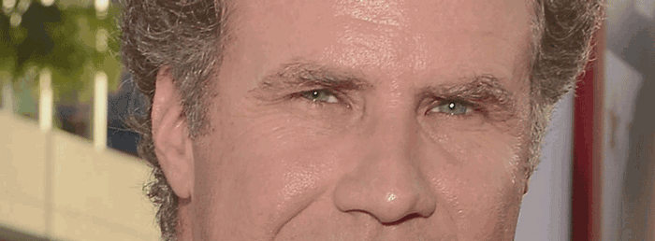
HOG Representation of the Image

Slide 13
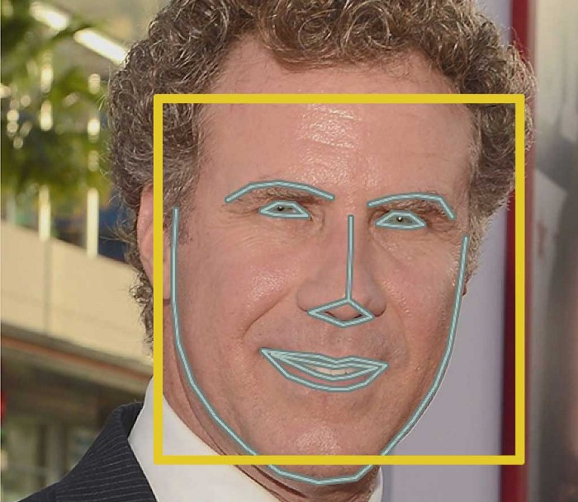
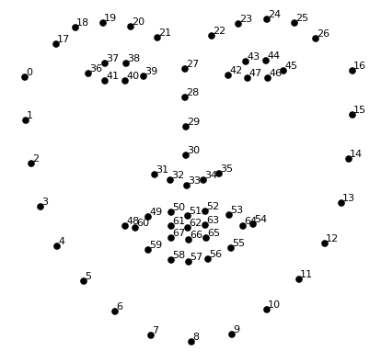
2) Posing and Projecting Faces

Slide 14
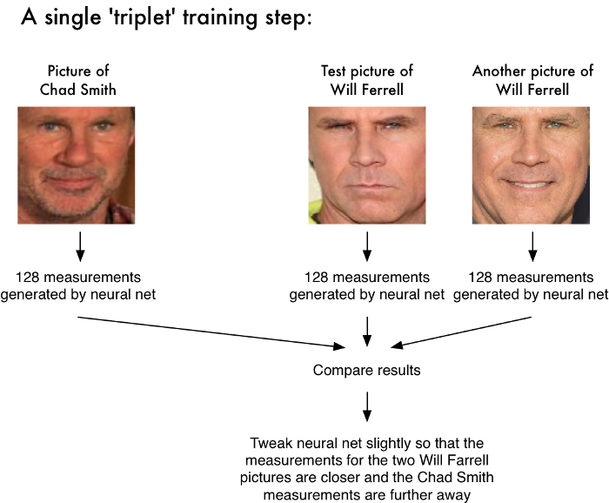
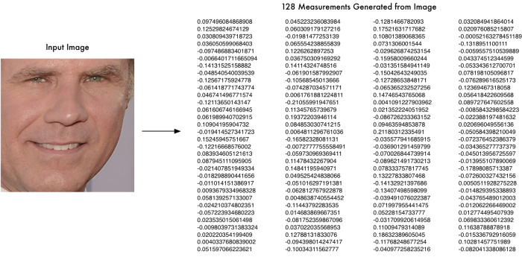
Encoding the Image

Slide 15
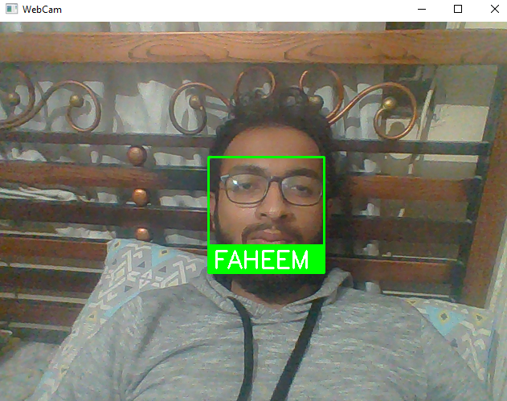
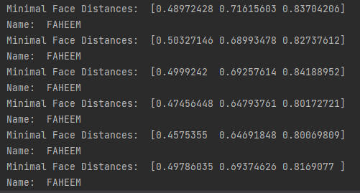
Testing Results of Face Recognition

Slide 16
THANK YOU!
Group Members:
Syed Muhammad Faheem (K201054)
Ishaqullah Siddique (K200148)
Sarim Latif Khan (K201644)

